Slide 1
Schedule C and Family Tax Planning
Chuck Li

Slide 2
The content is for personal knowledge sharing only, you should not construe such information or other material as legal, tax, investment, financial, or other advice from Wells Fargo or any other entity.
You may not reuse, republish, or reprint such content without our written consent.

Slide 3
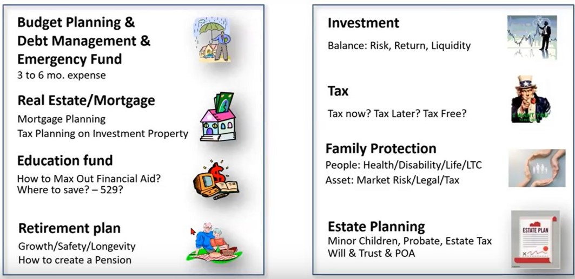
财务规划的八个方面

Slide 4
金融规划的目的是在市场风险， 未来税率， 退休的时机， 账户的提取率， 人的寿命， 人的健康等等的一系列不确定因素存在的环境条件下寻找事情存在发展的内在规律， 寻找和创造确定性机会： 保本投资， 保证免税投资，保证的永续收入，保证的长期护理保护等等。我鼓励每一个家庭每一位朋友在你人生的每一个阶段（工作学习生子退休等）的第一天都有一个金融计划。我认为每一位朋友都应该建立一个有纪律性的积极的（我反对消极的或者被动反应性的）的金融计划，在这个计划中在八大块儿的每一块都建立强有力的，实实在在的，有效的行事规则和方法来有效地管理自己的每一块钱。 孟子曰，无规矩不成方圆: 一个国家，一个企业如此，一个小家庭，一个人的小家庭也是如此。

Slide 5
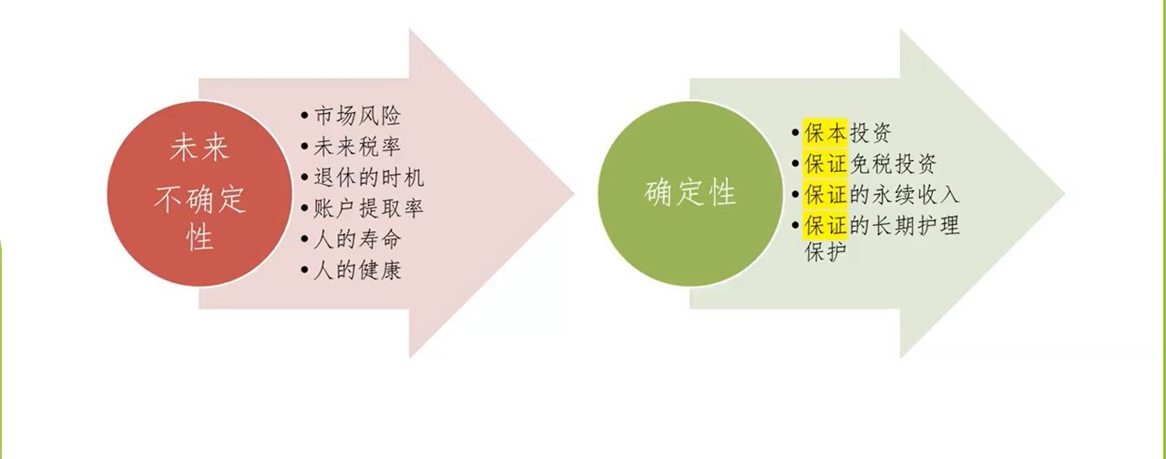
规律
金融规划的目的： 不确定性 --------> 确定性

Slide 6
The reasons using Schedule C
Some people have to use it as required by Tax Law/IRS
Lower tax liability, and lower tax brackets
Schedule C vs. Schedule E

Slide 7
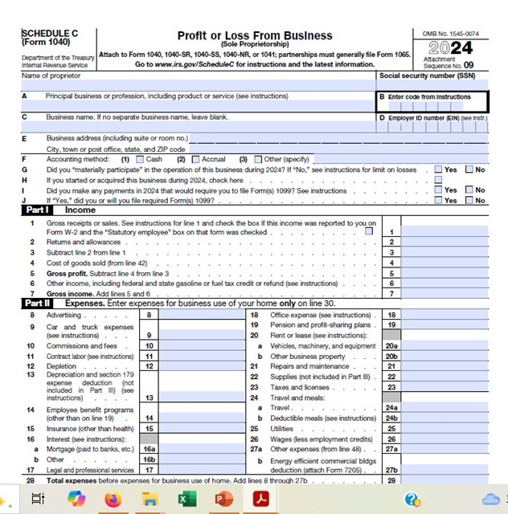

Slide 8
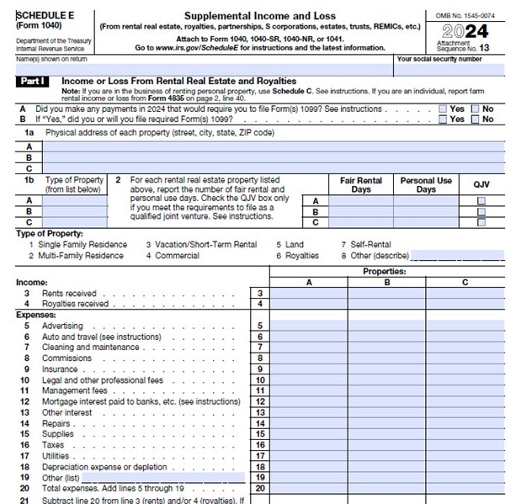

Slide 9
Employee (W2) | Entrepreneur (no W2)
Deduction Retirement contribution HSA & FSA Tax Withholding Federal and State Tax Withholding Payroll Tax | Deduction Retirement contribution HSA & FSA Business Expense Tax Withholding Can be none

Slide 10
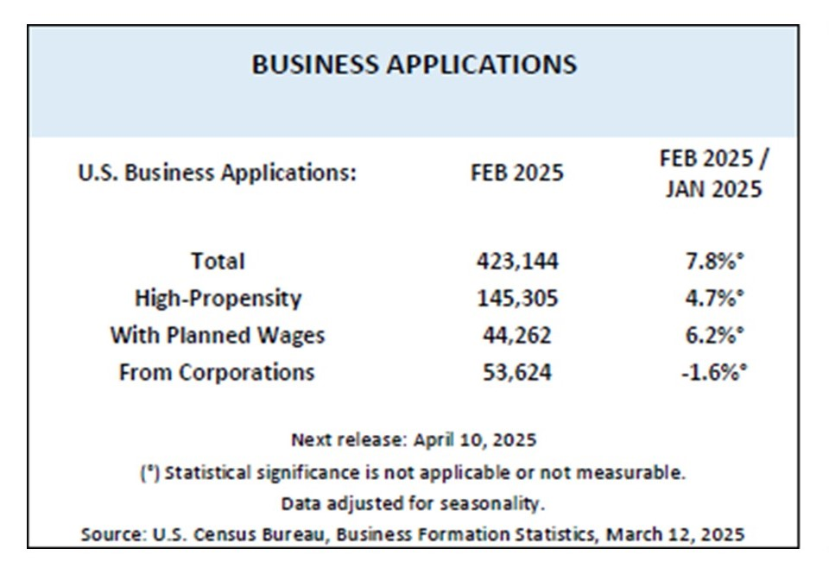

Slide 11
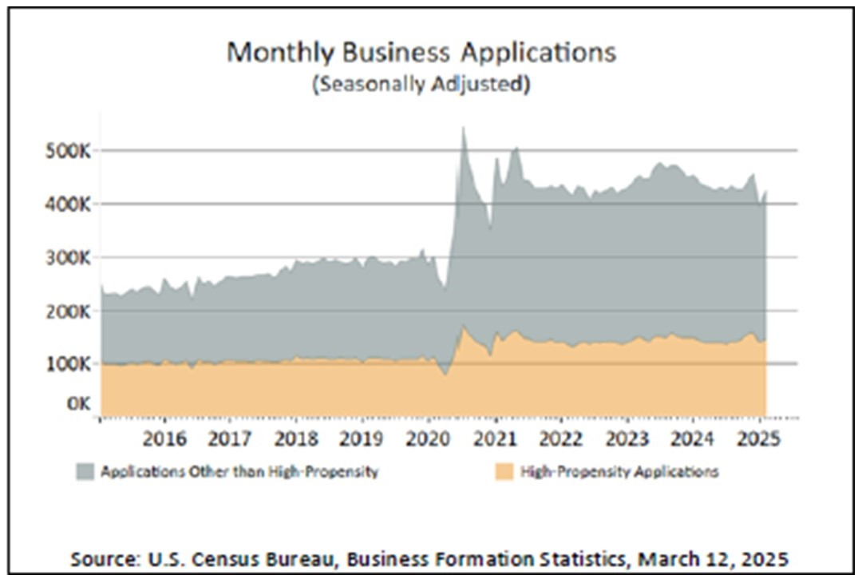

Slide 12
High-propensity businesses
As those that have a higher likelihood of becoming businesses with employees and payroll capabilities.
Dependent on an IRS Form SS-4 submission, businesses are deemed high-propensity based on characteristics associated with a high level of business formation

Slide 13
From Google AI:
As of 2023, the U.S. Census Bureau counted approximately 84.33 million families in the United States
There are approximately 34.8 million small businesses (500 employees or less) in the US, accounting for 99.9% of all businesses, and employing 59 million workers
Businesses with fewer than 20 employees: 89.0%
Businesses with fewer than 10 employees: 78.5%
In the US, a significant portion of small businesses, over 80%, are solo ventures, meaning they are managed solely by their owners with no additional employees

Slide 14
Importance of Solo Entrepreneurs:
Solo entrepreneurs play a vital role in the US economy, demonstrating independence and self-reliance.
American cultural values: Individual freedom and self reliance, equality of opportunity and competition, the American dream and hard work.
Chinese cultural values: justice, courtesy, wisdom, honesty, loyalty, self-discipline, and commitment

Slide 15
Types of the businesses
Sole Proprietorship
Partners
LLC
C Corporation:
Foreign shareholders
More than 100 employees
Double-taxation
S Corporation:
Less than 100 employee
All shareholders are US based
Pass through entity

Slide 16
Who can file Schedule C
Sole Proprietor:
Anyone operating a business,
No need to file a business with State
Local city or county government may require license such as rental license, plumber license etc
1099-NEC
Member of single person LLC, a partnership, a S Corp
People with a W2 employment and a side business or contract (no W2)

Slide 18
Car mileage:
Standard mileage rate: For business: $.67/mile for 2024, $.70/mile for 2025
Low maintenance car
Using less gas
No good bookkeeping
50 miles round trip from Woodbury to this Office, then on my way back to Shanghai Market to purchase Tofu Silk: tax deduction $35
Actual expenses:
Good bookkeeping;
Need to pro rata if used for multiple purposes;
High depreciation car
High maintenance car
High use of gas etc

Slide 19
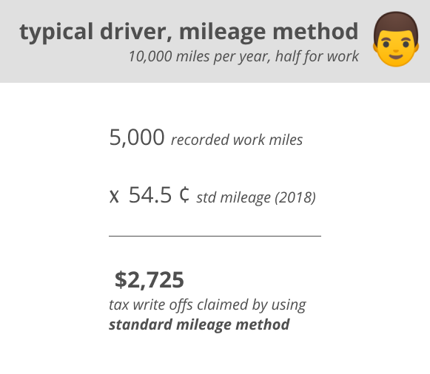

Slide 20
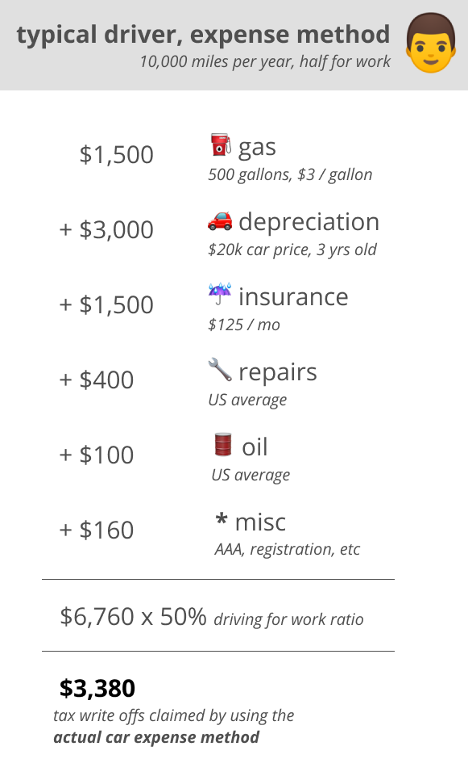

Slide 21
Tip:
Create a separate account for schedule C based business
Acquire a separate credit card for schedule C based expense

Slide 22
Contract Labor over $600:
1099-NEC
W9 form

Slide 23
Depreciation:
Special depreciation allowance for qualified properties and 80% bonus depreciation
7 years, 27 years depending on property types
Certain properties like computers may be classified as office expense then may not be able to depreciation
From IRS perspective, it would always assume you do depreciation no matter you do it or not.

Slide 24
Business Trips:
Needs to be mostly on business;
If less than or equal to 50%, then need to pro rata
Necessary

Slide 25
Meals and Activities:
100% Deductible Expenses: Includes holiday parties, open house meals, and certain business-critical meals.
50% Deductible Expenses: Includes client meals, business travel meals, and food for in-office meetings.
Non-Deductible Expenses: Includes entertainment (e.g., sporting events) and club memberships

Slide 26
Hiring minors in family and paying salary:
Encouraged by the IRS with tax benefits
Give them an actual job:
Make sure the work suits the child as well:
Pay reasonable wages:
Follow employment laws:
Keep good records:
Benefits and rules:
Shift income from a higher tax bracket to a lower one
Have an actual job as minors
Your child must be under age 18 for wages to be exempt from Social Security and Medicare taxes.
Once your child reaches age 21, you have to pay federal unemployment taxes on their wages.

Slide 27
Google AI:
The minimum income amount to file taxes depends on your filing status and age.
For 2024, the minimum income for Single filing status for filers under age 65 is $14,600.
If your income is below that threshold, you generally do not need to file a federal tax return.
If earn less than the standard deduction or the total of your itemized deductions,
If you have a certain number of dependents,
If you work abroad and are below the required thresholds,
If you're a qualifying non-profit organization.

Slide 28
Home Office Deduction: Schedule C line 30
Simple method: $5/sq X 300 sq (max) = $1,500
Need to have actual income
Actual Expense: IRS Form 8829

Slide 29
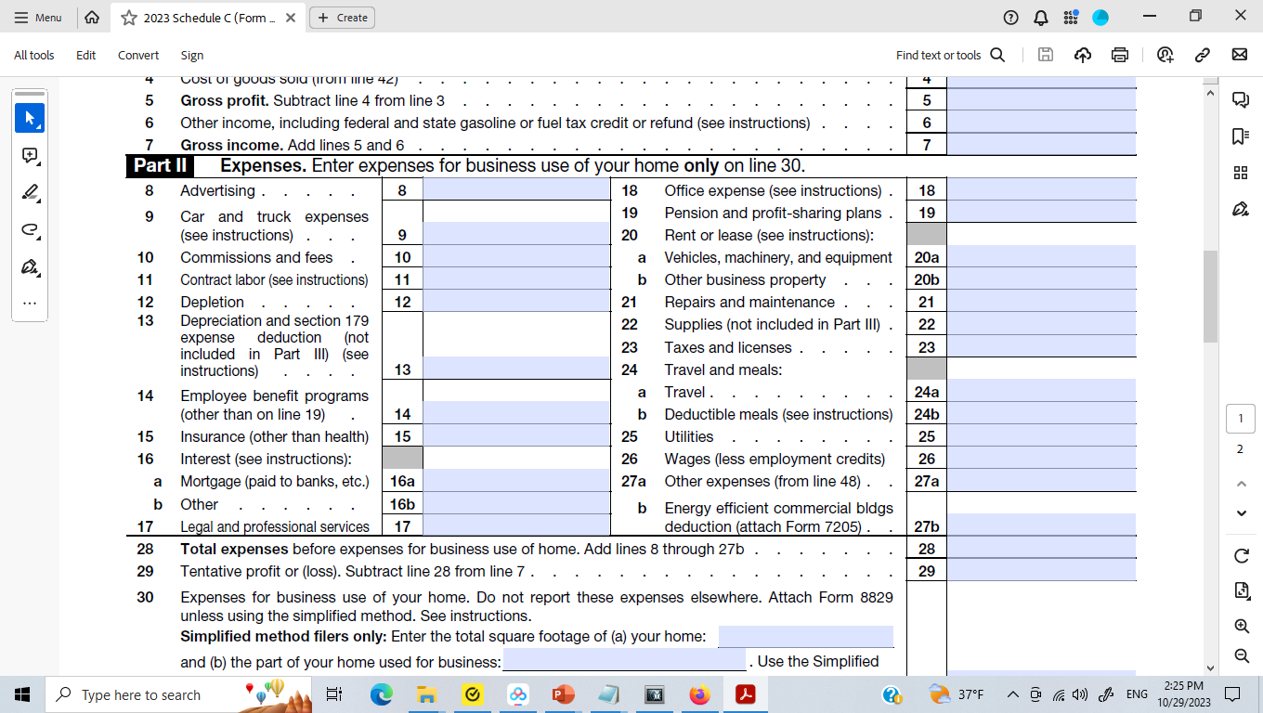




Slide 30
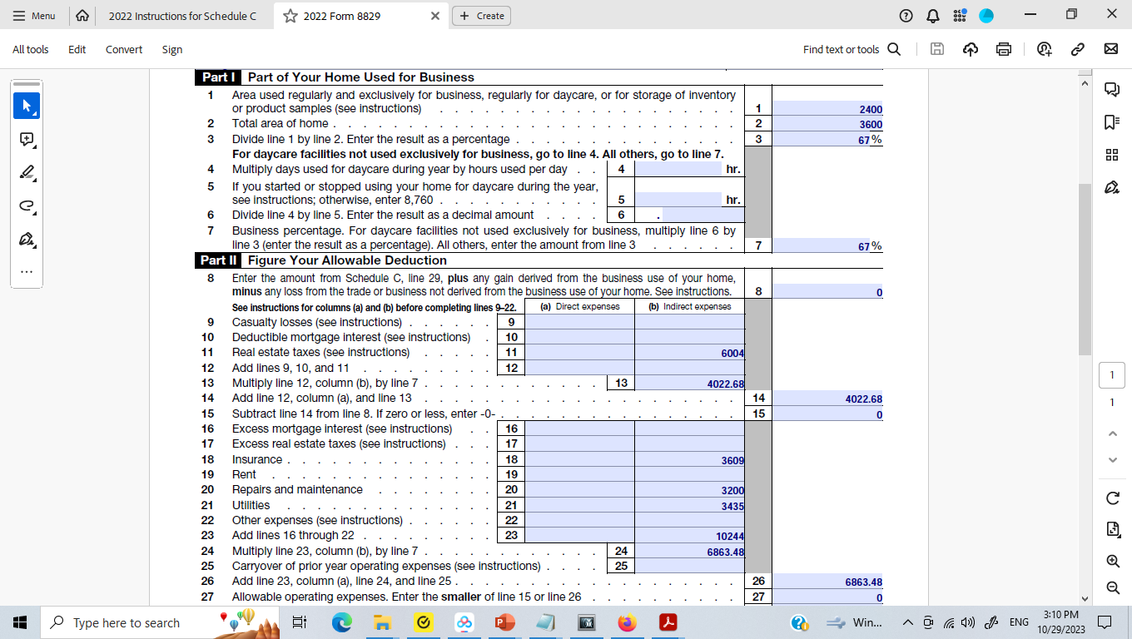

Slide 31
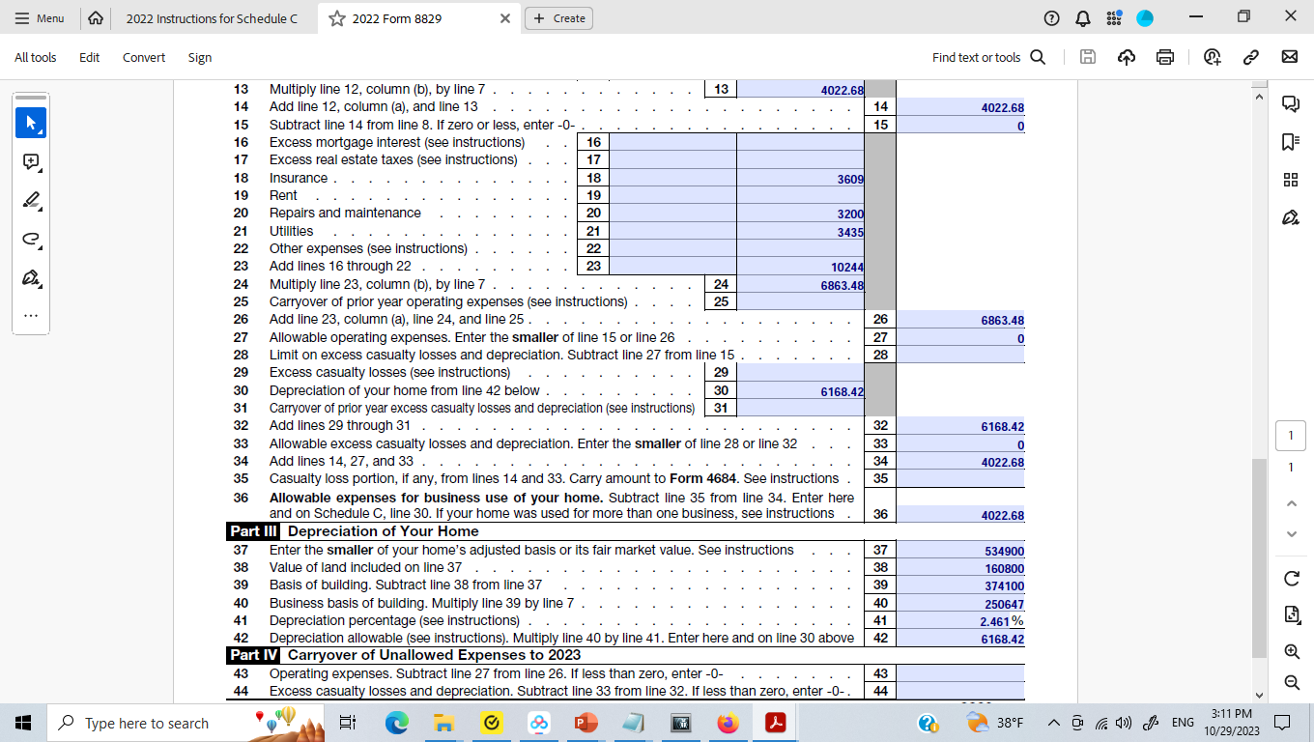

Slide 32
What can or can’t be deducted?
Ordinary and necessary;
No fine or penalties
No political contributions;
No illegal activities
No capital expense ( need to depreciated)
No hobby losses
No personal access

Slide 33



Slide 34

Line 14
Deduct contributions to employee benefit programs that are not an incidental part of a pension or profit-sharing plan included on line 19. Examples are accident and health plans, group-term life insurance, and dependent care assistance programs. If you made contributions on your behalf as a self-employed person to a dependent care assistance program, complete Form 2441, Parts I and III, to figure your deductible contributions to that program.
You cannot deduct contributions you made on your behalf as a self-employed person for group-term life insurance.
Do not include on line 14 any contributions you made on your behalf as a self-employed person to an accident and health plan. However, you may be able to deduct on Schedule 1 (Form 1040), line 17, the amount you paid for health insurance on behalf of yourself, your spouse, and dependents, even if you do not itemize your deductions. See the instructions for Schedule 1 (Form 1040), line 17, for details.
You must reduce your line 14 deduction by the amount of any credit for small employer health insurance premiums determined on Form 8941. See Form 8941 and its instructions to deter-mine which expenses are eligible for the credit.

Slide 35
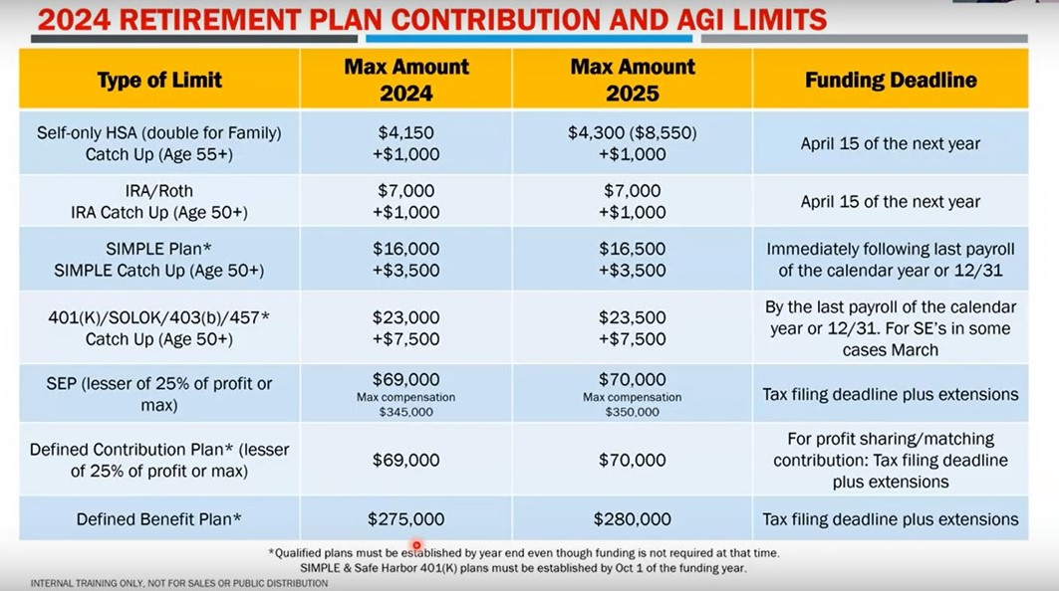

Slide 36
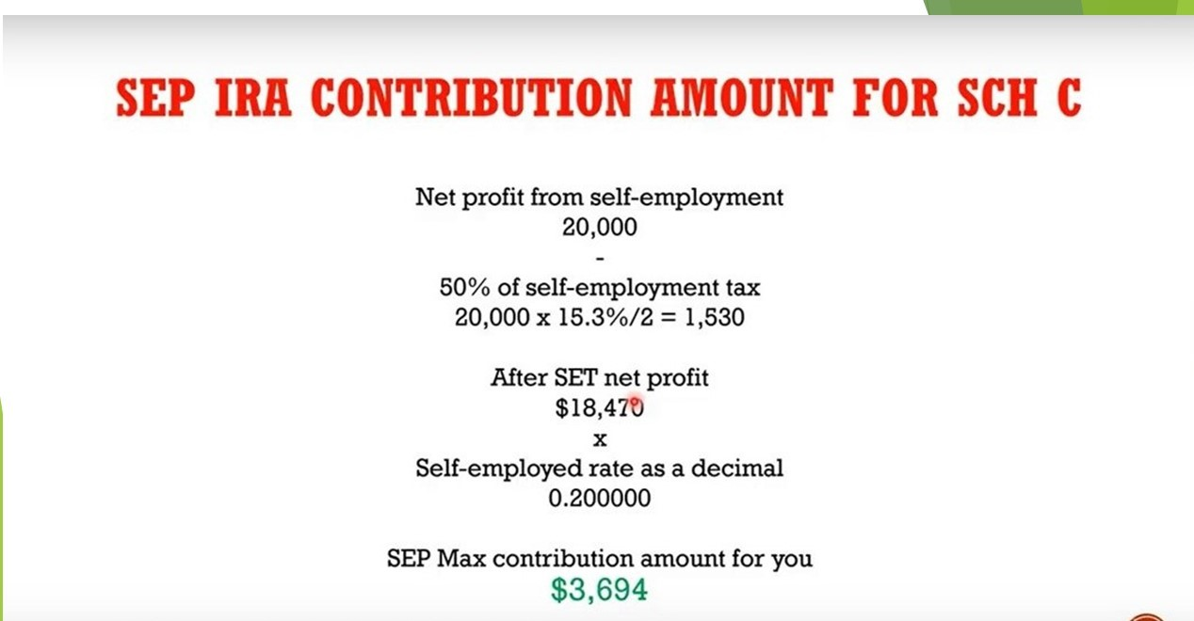

Slide 37
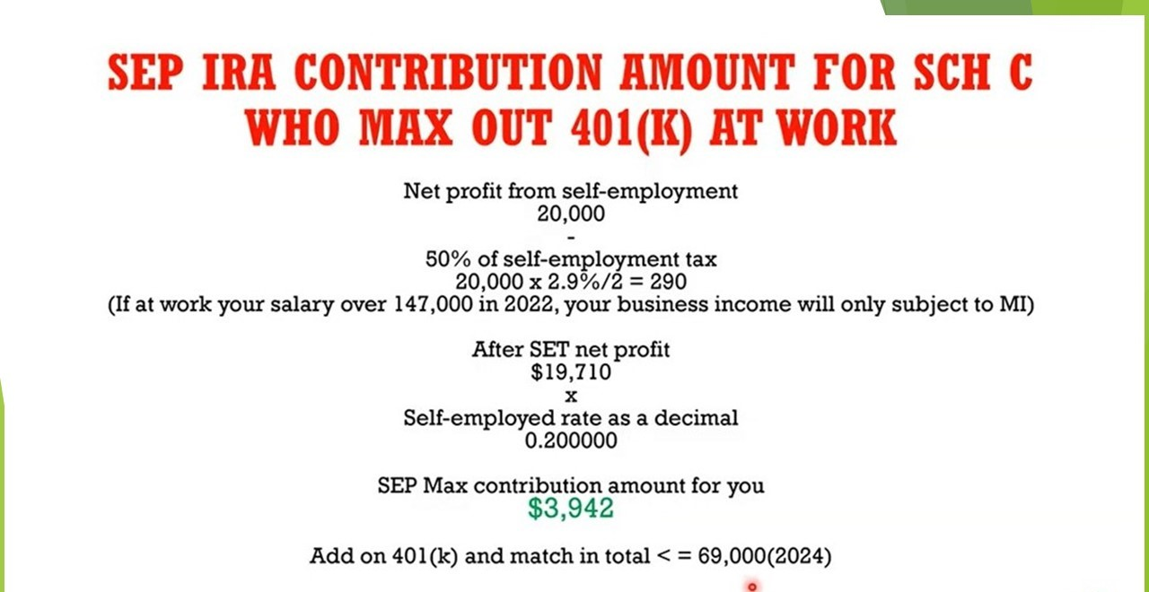

Slide 38
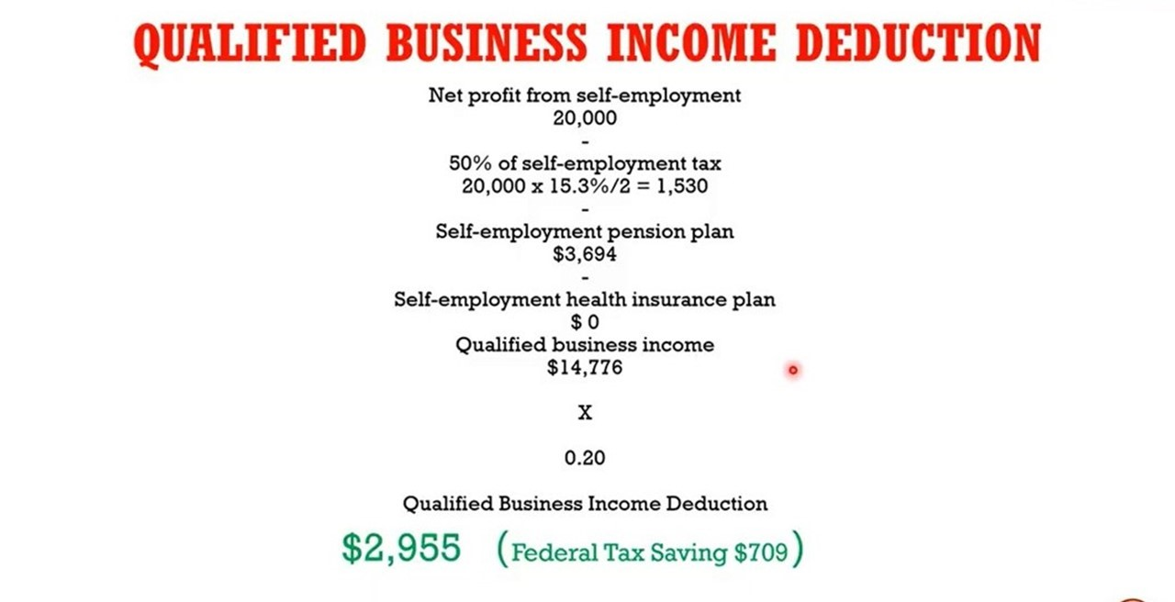

Slide 39
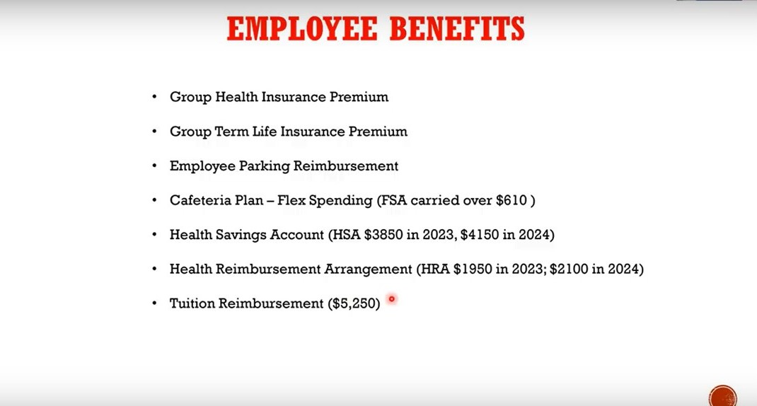

Slide 40
Line 15
Deduct premiums paid for business insurance on line 15. Deduct on line 14 amounts paid for employee accident and health insurance. Do not deduct amounts credited to a reserve for self-insurance or premiums paid for a policy that pays for your lost earnings due to sickness or disability. For details, see chapter 6 of Pub. 535.
Examples: HO6 insurance, etc

Slide 41
Line 19
Enter your deduction for the contributions you made for the benefit of your employees to a pension, profit-sharing, or annuity plan (including SEP, SIM-PLE, and SARSEP plans described in Pub. 560). If the plan included you as a self-employed person, enter the contributions made as an employer on your behalf on Schedule 1 (Form 1040), line 16, not on Schedule C.
This deduction may be subject to limitations. For more information on potential limitations, see Pub. 560.
In most cases, you must file the applicable form listed below if you maintain a pension, profit-sharing, or other funded-deferred compensation plan. The filing requirement is not affected by whether or not the plan qualified under the Internal Revenue Code, or whether or not you claim a deduction for the cur-rent tax year. There is a penalty for failure to timely file these forms.
Form 5500-EZ. File this form if you have a one-participant retirement plan that meets certain requirements. A one-participant plan is a plan that covers only you (or you and your spouse).
Form 5500-SF. File this form electronically with the Department of Labor (at efast.dol.gov) if you have a small plan (fewer than 100 participants in most cases) that meets certain requirements.
Form 5500. File this form electronically with the Department of Labor (at efast.dol.gov) for a plan that does not meet the requirements for filing Form 5500-EZ or Form 5500-SF.
For details, see Pub. 560.

Slide 42
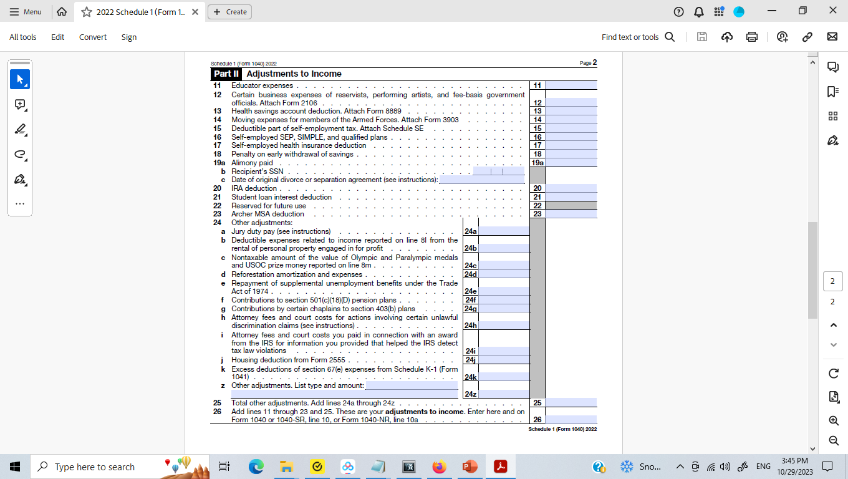


Slide 43
https://www.irs.gov/retirement-plans/self-employed-individuals-calculating-your-own-retirement-plan-contribution-and-deduction
Plan compensation for a self-employed individual
To calculate your plan compensation, you reduce your net earnings from self-employment by:
the deductible portion of your SE tax from your Form 1040 return, Schedule 1, on the line for deductible part of self-employment tax, and
the amount of your own (not your employees’) retirement plan contribution from your Form 1040 return, Schedule 1, on the line for self-employed SEP, SIMPLE, and qualified plans.
You use your plan compensation to calculate the amount of your own contribution/deduction. Note that your plan compensation and the amount of your own plan contribution/deduction depend on each other - to compute one, you need the other (this is a circular calculation). One way to do this is to use a reduced plan contribution rate. You can use the Table and Worksheets for the Self-Employed (Publication 560) to find the reduced plan contribution rate to calculate the plan contribution and deduction for yourself.
Deducting retirement plan contributions
Total limits on plan contributions depend in part on your plan type. See the contribution limits for your plan.
A limit applies to the amount of annual compensation you can take into account for determining retirement plan contributions. This limit is $330,000 in 2023, $305,000 in 2022, $290,000 in 2021, $285,000 in 2020 and $280,000 in 2019 and is adjusted annually.
Plan contributions for a self-employed individual are deducted on Form 1040, Schedule 1 (on the line for self-employed SEP, SIMPLE, and qualified plans) and not on the Schedule C. If you made the deduction on Schedule C, or made and deducted more than your allowed plan contribution for yourself, you must amend your Form 1040 tax return and Schedule C.
You should amend your Form 1040 tax return and Schedule C if you:
deducted your own plan contribution on Schedule C instead of on Form 1040, Schedule 1, or
made and deducted more than the allowable plan contribution for yourself.
If you contributed more for yourself than your plan terms allowed, you should also correct this plan qualification failure by using the IRS correction programs.

Slide 44



企业退休和福利计划的选择
自雇或者无员工企业主
有员工的企业主
Simple IRA（储蓄激励配比计划）
401k （401k 退休储蓄计划）
Profit Sharing（盈利分享退休计划）
Defined Benefit Plan （退休福利计划）
Cash Balance Plan （现金余额计划）
NQDCs （递延报酬计划）
Executive Bonus Life （高管保险计划）
Key Person Life with Buy-Sell Agreement （关键人保险和买卖协议）
SEP（简易雇员退休金计划）
Single K （个人401k计划）
Single DB （个人DB计划）

Slide 45

什么样的收入可以计算入退休账户（必须是劳务收入）
Compensation Quick Reference Chart
Entity Type | Source of Income | Compensation for Plan
Corporation | W-2 Income | W-2 Income
S-Corporation | W-2 + Schedule K-1 | W-2 Income only
Sole Proprietorship | Schedule C (net profit) | Earned Income (calculate)*
Partnership | Schedule K-1 (net profit) | Earned Income (calculate)*
Earned Income = net profit minus 1/2 self employment tax minus plan contribution. Deductions for sole proprietors and partners are limited to net profit minus 1/2 self-employment tax.

Slide 46
2025年度退休账户限制一览表
项目 | 2025年 | 2024年
401(k)和403(b), 457员工收入抵扣额度 | 23,500 | 23,000
401(k), 403(b), 457，补充额度（Aged 50-59 and 64+, thanks to SECURE 2.0） | 11,250 | 7,500
401(k), 403(b), 457，补充额度（Aged 60-63） | 7,500 | 7,500
Combined Employee and Employer Contribution Limit | 70,000 | 69,000
SIMPLE员工收入抵扣额度 | 16,500 | 16,000
SIMPLE补充额度（50岁以上员工） | 3,500 | 3,500
退休金计算收入上限 | 350,000 | 345,000
DB计划年收入福利上限 | 280,000 | 275,000
415 Profit Sharing, SEP年存入额度上限制 | 70,000 or 25% of income | 65,000
HCE高收入员工收入界定 | 160,000 | 155,000
Key Employee关键人员工收入界定 | 230,000 | 225,000
社会保障应税工资基数 | 176,100 | 168,600

Slide 47
IRA账户
 | IRA | Roth IRA
参与条件 | 个人： $6,000, 50岁以上$7,000 有Earned Income, 无年龄限制 | 个人： $6,000, 50岁以上$7,000 有Earned Income，无年龄限制
税务好处 | 抵税 + 缓税 | 缓税 + 免税
收入限制 | 无，抵税有收入限制 | 有(2021 MAGI $198k-$208k)
取用条件 | 缴收入所得税，59.5岁前10%罚金 | 59.5岁前本金随意取用，利息5年rule， 59.5岁后随意支取
强制取钱 | 72岁RMD | 无限制
非配偶传承 | 10年内用完 | 无限制

Slide 48

SEP and Solo K
 | SEP | Solo K
资金存入要求 | 一部分 公司放钱： 工资的25% 或者公司调整盈利的20% 上限($61,000, 2022年) | 两部分 个人401k/Roth 401k部分：上限$20,500 公司放钱Profit Sharing： 工资的25% 或者公司调整盈利的20% 上限($61,000, 2022年)
税务好处 | 抵税 + 缓税 | 抵税 + 缓税
参与条件和维护 | “松”员工：最严超过21岁，5年内工作满3年，年收入超过$600,合格员工必须放一样比例。维护简单不需要filing。 | 员工：最严超过21岁，工作满一年，年工作超过1000小时。维护简单，额度在$250k以下不需要filing 5500表
成立时间 | 报税截至日期前 | 年末12/31
如果你今年busines收入$100k? 两个账户各可以放多少？

Slide 49
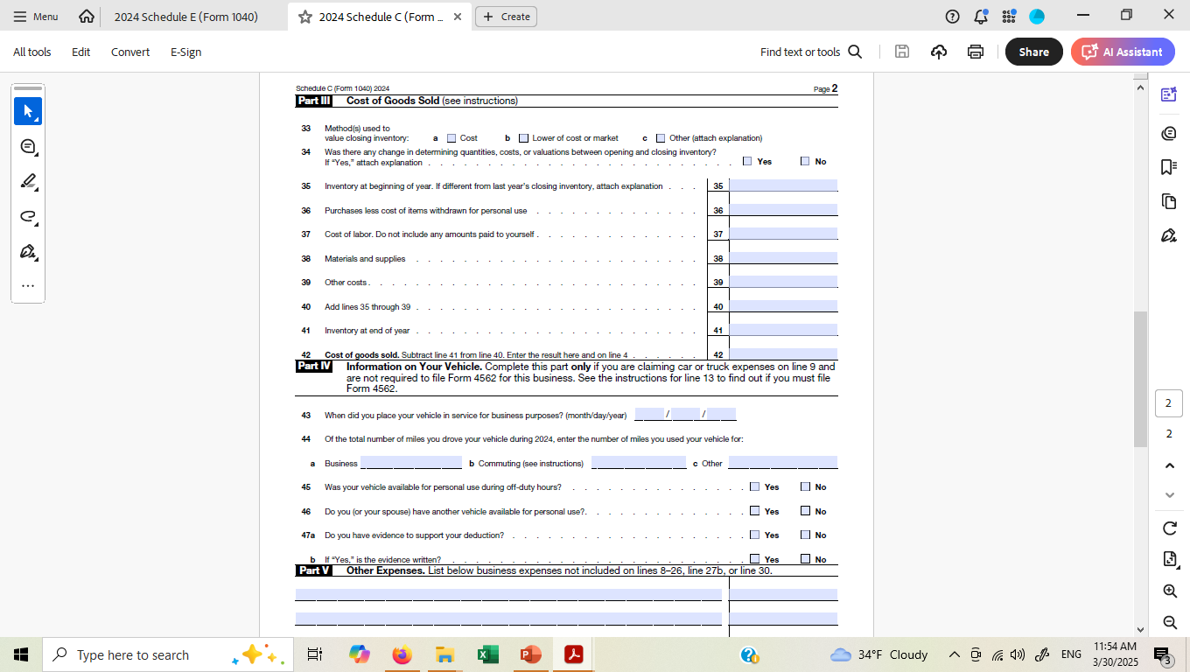

Slide 50
Part III Cost of Goods Sold:
Have inventory
Online business
Certain international trades

Slide 51
Part IV Car usage

Slide 52
Part V: Other Expense

Slide 53
Can I deduct life insurance premiums as a business expense LLC?
Although the Internal Revenue Service permits LLCs to deduct most insurance premiums as a business expense, life insurance premiums are not eligible. But, if you are the owner of an LLC and are paying life insurance premiums for employees, these premiums may be deductible.

Slide 54
The most common triggers for a Schedule C audit are:
Failing to report all of your self-employment income
Claiming incorrect tax deductions (deducting personal expenses as business expenses)
Failing to report capital gains when you sell business property
Exceeding the standard mileage deduction
Overstated business losses
A Schedule C that is significantly inconsistent with previous years or other similar taxpayers
Operating in a cash-heavy or “risky” industries

Slide 55
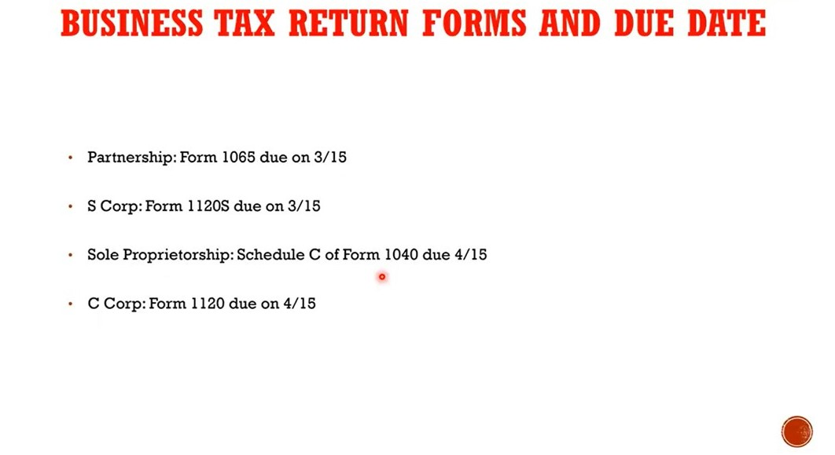

Slide 56

Q&A?

